Slide 1
TrendWave
A social media trend app designed for SMBS and creators
.
Kexuan Chen | kexuanch@andrew.cmu.edu
Yanijing Huang | yanjingh@andrew.cmu.edu
Swapnil Panwala | spanwala@andrew.cmu.edu
Hetong Wang | hetongw@andrew.cmu.edu

Slide 2




TEAM
Swapnil Panwala
Title: Co-founder & CTO
https://www.linkedin.com/in/spanwala/
Kexuan Chen
Title: Co-founder & CAIO (Chief AI Officer)
https://www.linkedin.com/in/kexuanchen/
Yanjing Huang
Title: Co-founder & CEO
https://www.linkedin.com/in/yanjinghuang/
Hetong Wang
Title: Co-founder & CDO (Chief Data Officer)
www.linkedin.com/in/hetong-wang-b332b1246

Slide 3
Agenda
Team
Vision
Problem
Our Solution (features & demo)
Projected Impact
Business Model
Go-to-Market

Slide 4
Our Vision
Our vision is to empower SMBs and individual content creators with an intuitive, powerful tool that takes the guesswork out of social media strategy. TrendWave doesn't just provide data – it delivers actionable insights. We transform complex trend analysis into clear content suggestions, allowing our users to focus on their business.

Slide 5

Problems
All current solutions are behind a paywall that cost from $50-$800+/month with Enterprise solutions starts at $1,000 which is too much for SMBs and content creators to start their career.
SMBs & Content Creators:
Lack of social media team
Overwhelming complexity in trend data
No real-time analysis available
NO FREE EASY TO USE TOOL!!!!

Slide 6

Our solution: TrendWave

Slide 7

Features

Slide 8
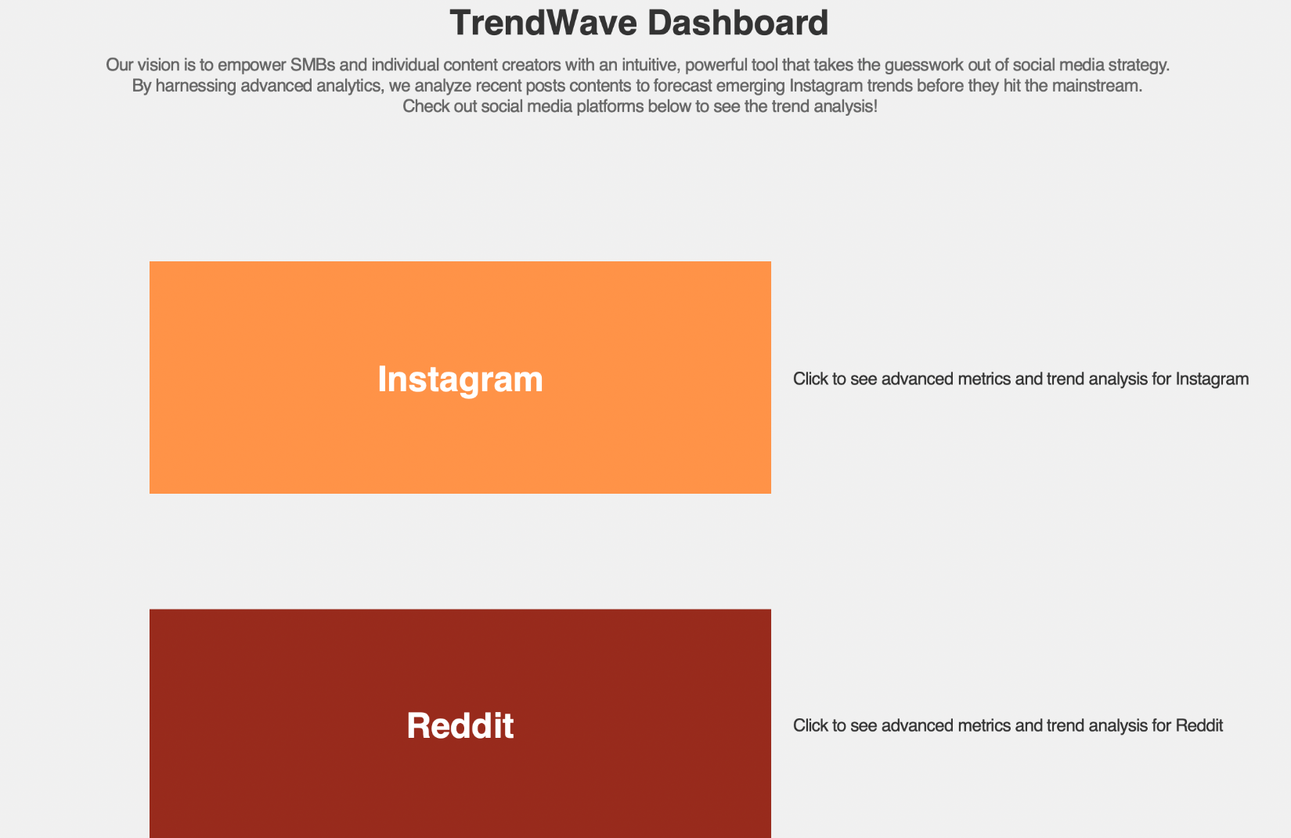

Product Demo

Slide 9
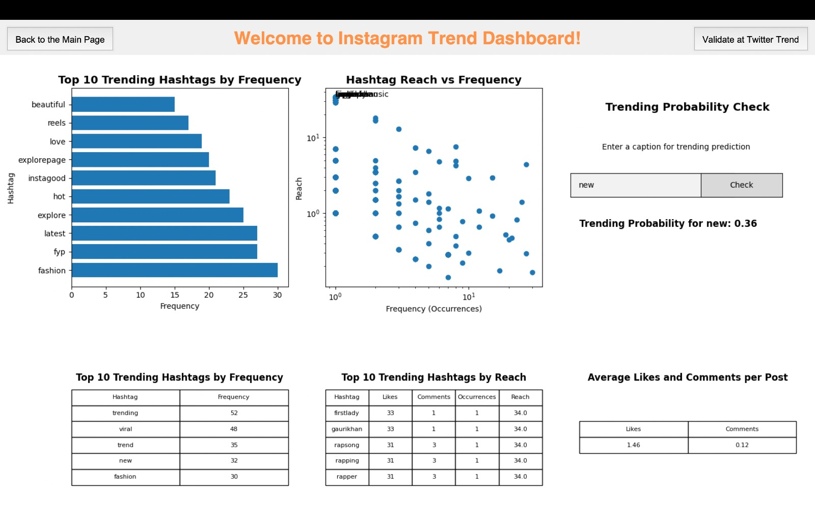
Product Demo
Interactive
prediction model

Slide 10
Product Demo

Slide 11
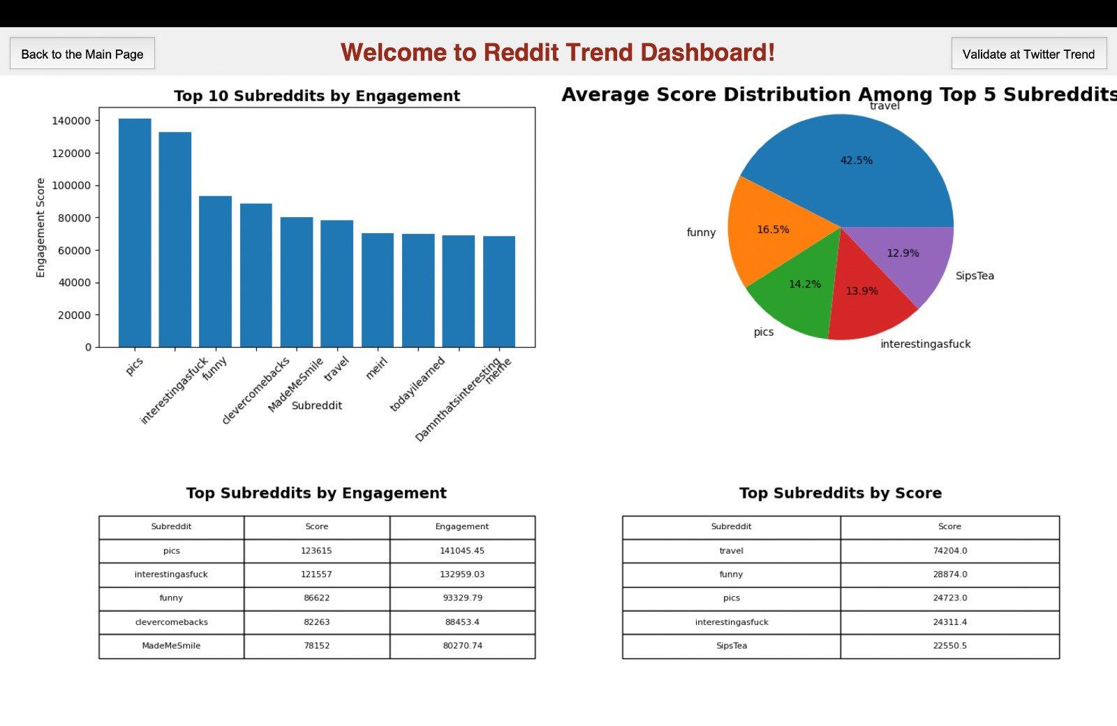
Features

Slide 12
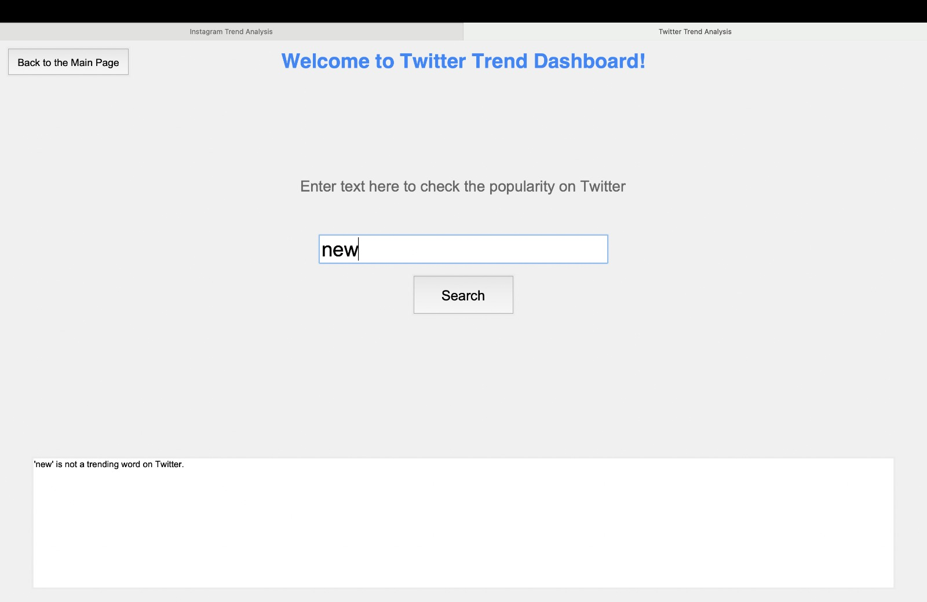
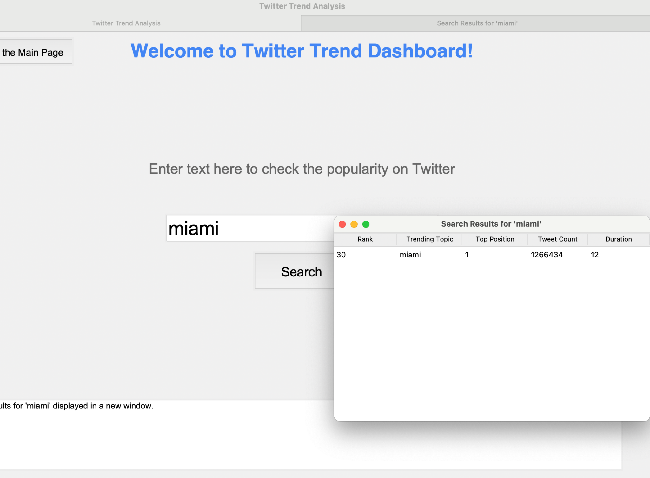
Features

Slide 13
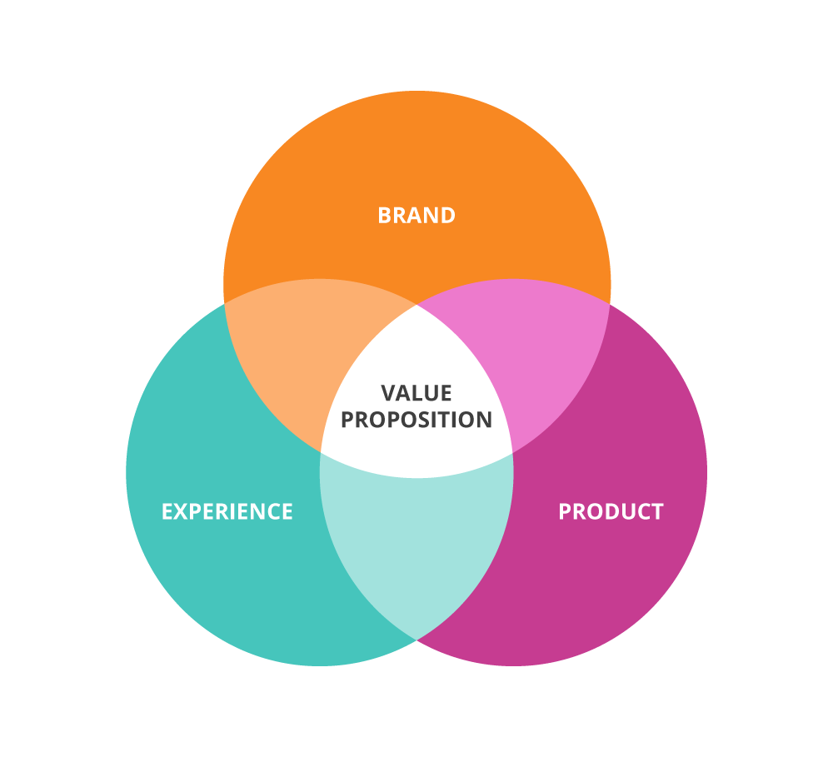
Value Proposition
Help SMBs and content creators to stay ahead
Optimize marketing strategies
Boost engagement without extensive resources or time

Slide 14
Projected Impact
10hr
30%
25%
3X
Time
Engagement
Follower
Revenue
Save 10+hours/week
30% increase in post engagement
25% faster growth in followers
3X ROI in social media marketing

Slide 15


Projected Impact
Target customer
Market Size
Small and medium-sized companies and Startups
Content Creators
Individual Influencers
$14.4 billion in 2021, expected to reach $41.6 billion by 2026 with CAGR of 23.6% (source: MarketsandMarkets).

Slide 16
Business Model
Packages
Pricing
API ACCESS
-Basic package is FREE!
-Premium features are available with subscription
Individual Creator: $19.99/month
SMB & Startups: $49.99/month
Agency:$149.99/month
User can order custom API for integration with other tools at additional cost

Slide 17


Competition
Direct competitors:
Hootsuite Insights
Sprout Social
Later
Indirect competitors:
General social media management tools (Buffer, Planoly)
Manual trend research methods
Our Advantages:
Specialized in trend predictions
Design for small and mid size customers
Affordable pricing with outstanding performance
Machine learning model specifically for social media data

Slide 18



TrendWave
Sign up today for free X, Instagram, and Reddit trends predictions!

